Slide 1
LASER SECURITY SYSTEM WITH REMOTE ACCESS
TEAM 37
SANTOSH B NAIK 211EE144
SUCHET B 211EE152
SUMUKH S K 211EE153

Slide 2
INTRODUCTION
Need of security is the necessity of any individual. The feeling that we are safe and everything around us is all right is imperative for a peaceful living.
Laser security system provides us with an assured security and for this reason more and more people are installing them in order to stay safe and secure.
Laser light doesn't spread out, it is a narrow beam. And laser light is essentially a single colour

Slide 3
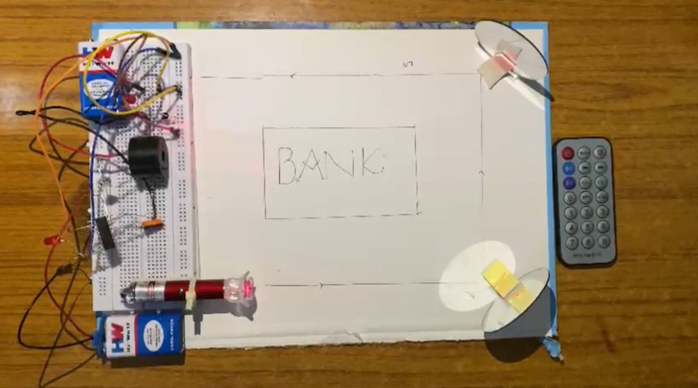
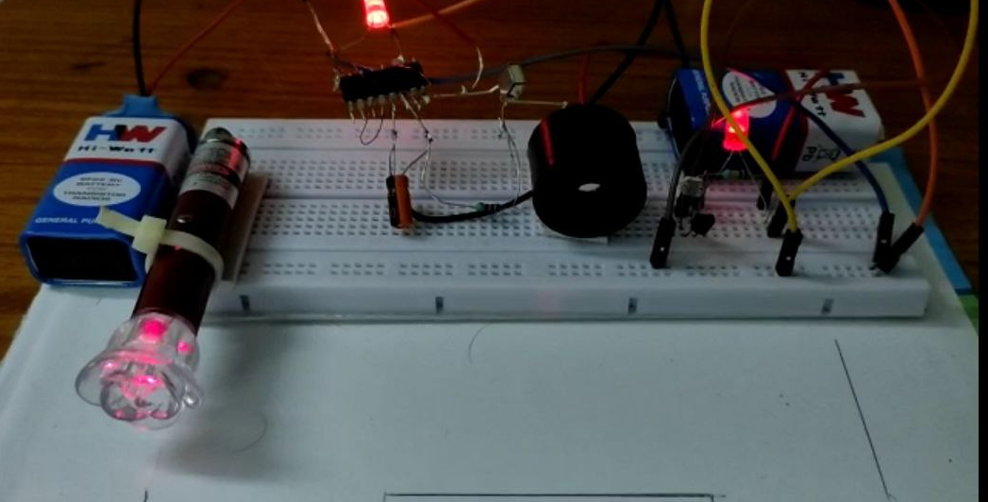
LASER SECURITY SYSTEM WITH REMOTE ACCESS

Slide 4
PRINCIPLE
There are three essential components to a laser security system:
1.LASER: The laser is a concentrated light source that puts out a straight line, 'pencil beam’ of light of a single colour.
2.THE DETECTOR: The detector is sensitive to light and puts out a voltage when the laser light hits it. The detector is connected to the sensing circuit. When the laser beam is interrupted and cannot reach the detector, LDR sensor transmits a signal and switches the buzzer on and gives out an alarm.
3.REMOTE ACCESS: Second major part of our project includes an IR receiver and transmitter circuit. The transmitter emits IR radiation which will be sensed by IR receiver. The signal sent out by transmitter is unique (coded in binary using combination of high and low outputs) . Thus, any random transmitter cannot set out same signal and toggle security system circuit.

Slide 5
RELATION WITH EMT
Electromagnetic waves, which is treated as one of the most important outcomes of EMT is related majorly to the scope of this project. Two waves i.e., Laser and IR which are produced due to time varying electric and magnetic fields propagating perpendicular to each other is used to build a security system with remote access in simplest of ways.
LASER is an acronym for Light Amplification by Stimulated Emission of Radiation. It’s constructed from 3 basic components: a lasing medium, an energy source and an optical resonator. Laser wavelengths are usually in the Ultraviolet, Visible or Infrared Regions of the Electromagnetic Spectrum.
IR LED is a special type of LED that emits Infrared rays of the Electromagnetic Spectrum. A typical IR LED emits infrared rays in a wavelength range of 740 – 760 nm.

Slide 6
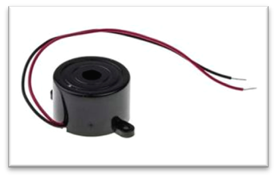
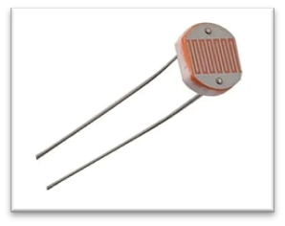
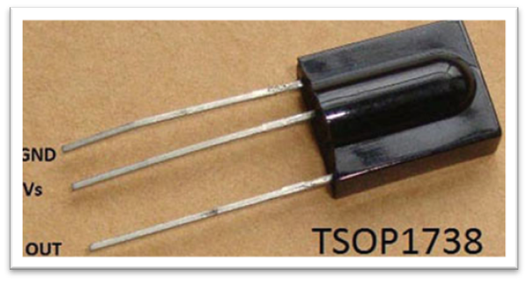
COMPONENTS USED
Laser
LDR (Light Dependent Resistor)
Buzzer (5V)
Battery
Resistor (1k , 100k ohm)
Transistor (BC547)
Capacitor (10macroF, 63V)
LED lights
Bread board
IC (CD4017)
IR Receiver
Remote
Connecting wires (Jumper wires)
Mirrors
BUZZER
LDR SENSOR
IR RECEIVER

Slide 7
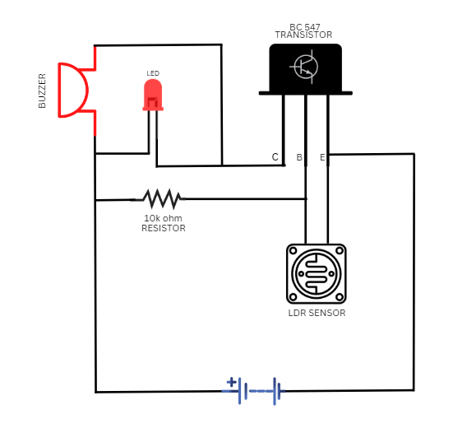
WORKING
The basic sensing component of a modern laser security system is motion detector. The motion detector contains four parts: The laser, the mirrors, the detector and the sensing electronics. An infrared detector works by projecting a beam of light that shoots across a space into a series of mirrors and finally into a detector(LDR), which emits a particular voltage into the sensing electronics as long as the laser hits it. When the beam of light is broken, the detector changes its voltage output into the sensing electronics, which then trigger an alarm.
CIRCUIT DIAGRAM

Slide 8
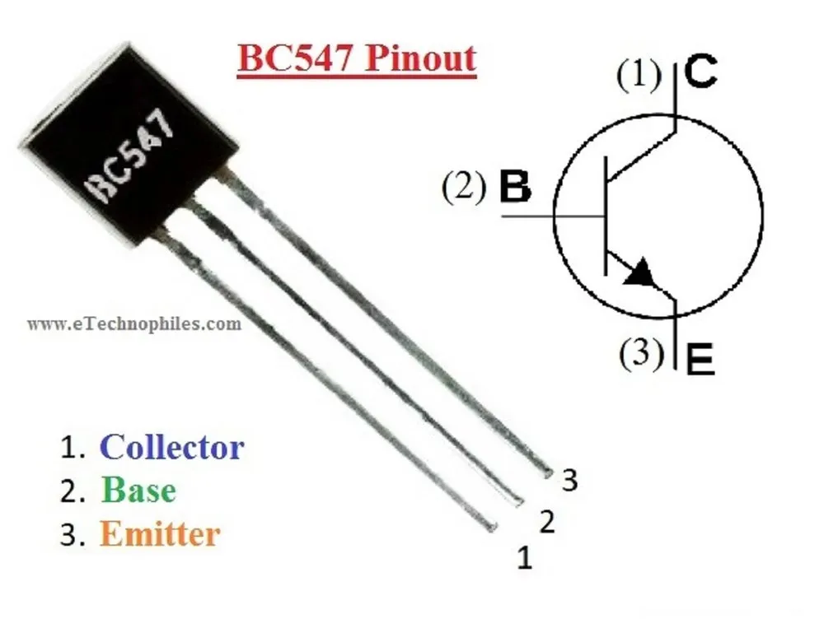
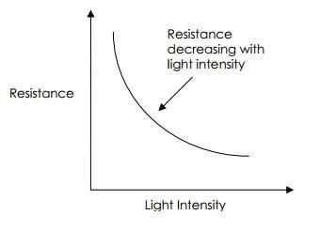
WORKING : BC 547 TRANSISTOR & LDR
BC547 is the transistor used here. This particular transistor has 3 legs: collector, base and emitter. The current flows from collector to emitter only is some current is passed through the base leg.
Basically, this BC547 transistor acts as a switch which turns on when some current passes through base leg.
LDR is connected to base and emitter terminals of transistor. LDR is basically a resistor whose value depends on intensity of light.
LDR’s resistance is inversely proportional to the intensity of incident light as shown in the graph. As laser acts on a very low area, it’s intensity turns out to be immensely high and thus LDR’s resistance will be low. Hence LDR conducts.
But when Laser’s path is interrupted intensity of light falling upon LDR will be zero inturn it’s resistance will be high. Thus LDR does not conduct. Hence, current flows through base leg of transistor.
As a result of this, current flows from collector to emitter which turns on the buzzer circuit and that’s how buzzer goes on.
BC547 TRANSISTOR
GRAPH OF INTENSITY VS RESISTANCE

Slide 9
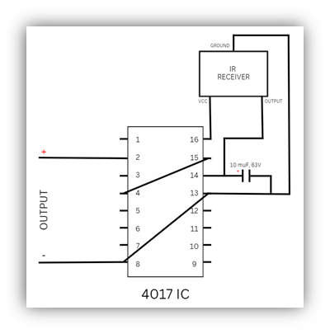
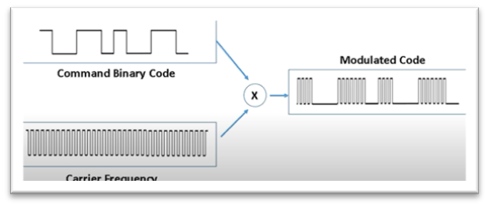
WORKING
The principle of Infrared (IR) communication using IR Transmitter and Receiver is explained here. The working of the project is as follows. As mentioned earlier, the circuit is divided into IR transmitter and IR receiver circuits. The infrared rays emitted by the IR Transmitter i.e., IR LED must be detected by the IR Receiver, timer is designed to operate in.
The output from IR receiver is programmed in binary and is modulated with is high frequency wave. As the transmitted wave is unique, it can never mix with other signals. Thus, any other random remote cannot turn our security system on or off. The access remains only with the people who actually own the secured facility.
UNIQUE MODULATED WAVE
IR RECEIVER CIRCUIT DIAGRAM

Slide 10
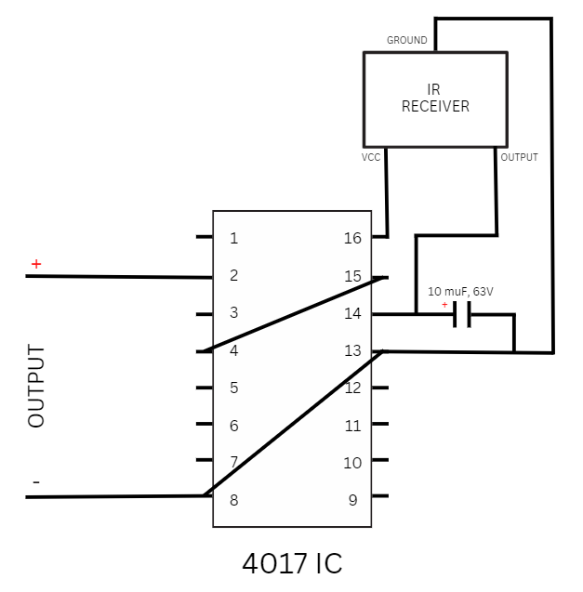
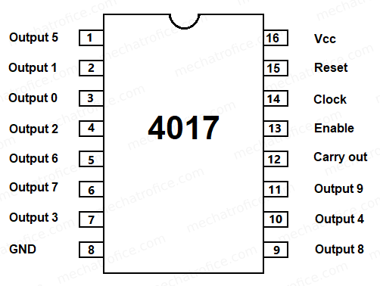
WORKING : 4017 IC
IC 4017 is a decoder with 10 decoded outputs.
It has an input line called clock & multiple output lines which can be decoded in many sequenced or number systems.
Every time it senses an input wave, clock gets incremented.
This IC will give an output voltage only if it gets its desired input in expected sequence.
UNIQUE MODULATED WAVE
IR RECEIVER CIRCUIT DIAGRAM

Slide 11
APPLICATIONS
Laser Security System can be used in safety lockers in our homes, where even if the locker's code is hacked, it acts as an additional layer of security.
These laser systems can be installed in homes either by self or by hiring a technical person. By technological innovations cost of the security systems has been cut to a large extent. So, making laser systems one among affordable security system options can be very safe.
Lasers are strong in beam width and can be focused on the perfect target. By using laser security system one can be safe in the case of harmful effects to the body. As the beam width used in the laser security systems are not strong beam widths.
The circuit, construction and setup for the Laser Security System are very simple. If used with a battery, the laser security system can work even when there is a power outage
Apart from security systems, this laser-based setup can also be used to check if pets or babies crossed a certain boundary.

Slide 12
CONCLUSION
Laser security system provides us the security against any crime, theft in our day-to-day life and so people are installing them in order to stay safe, secure and sound. Various electronic security systems can be used at home and other important working places for security and safety purposes. It is a great opportunity and source of saving man power contributing no wastage of electricity. The "Laser Security System" is an important helping system. Using this system robbery, thefts & crime can be avoided to large extend. Avoiding thieves’ results in the safety of our financial assets and thereby this system provides us protection against all.
The Laser & LDR system is highly sensitive with a great range of working. The system senses the light emitted by the Laser falling over the LDR connected with the circuit. Whenever the beam of light is interrupted by any means, it triggers the alarm or siren. This highly reactive approach has low computational requirement; therefore, it is well suited to surveillance, industrial application and smart environments.

